Slide 1
Tutorial 2 Extra Notes
How to write readable & manageable code

Slide 2
End goal
Code that is easy to understand (Readable)
i.e. mostly self-explanatory
Code that is easy to add on to (Manageable)

Slide 3
Level 1: Commenting, Naming, and Formatting

Slide 4
Context
Terrible code generously crafted and donated by a friend.

Slide 5
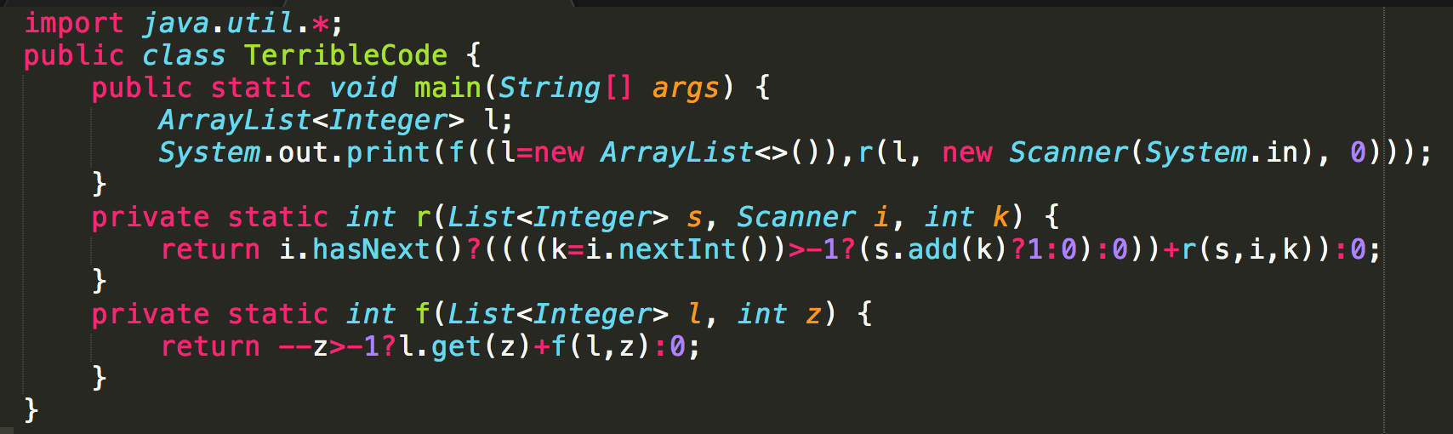
Mystery Code
You have 10 seconds.

Slide 6
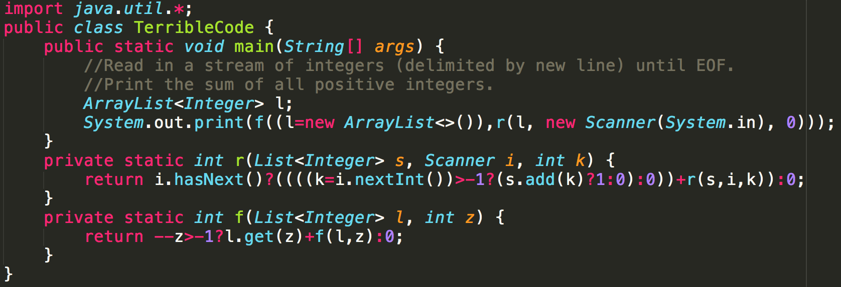
Mystery Code
Better?
No.
Notes:
Comments

Slide 7
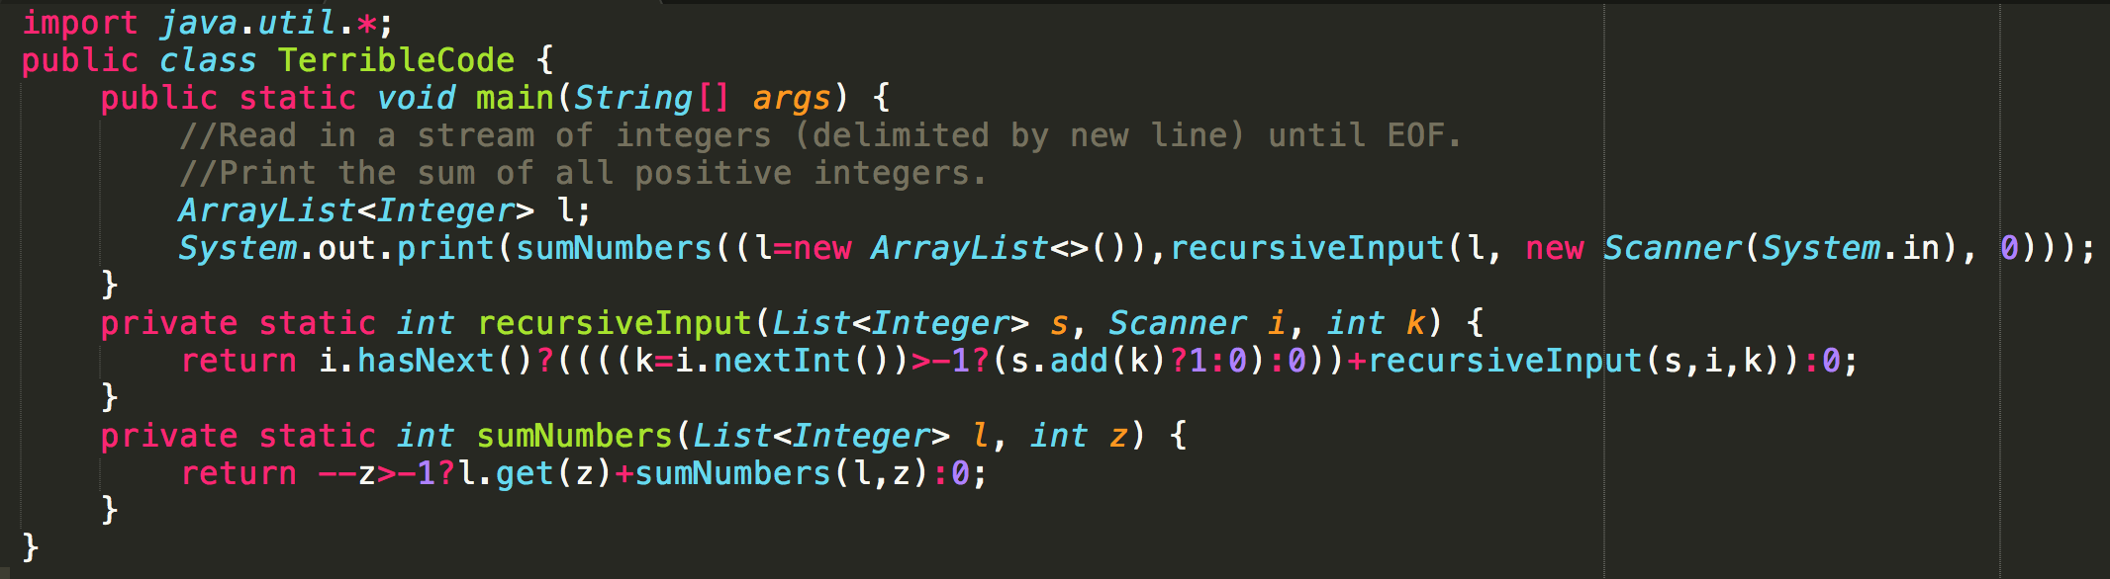
Mystery Code
Better?
A bit.
Notes:
Naming methods

Slide 8
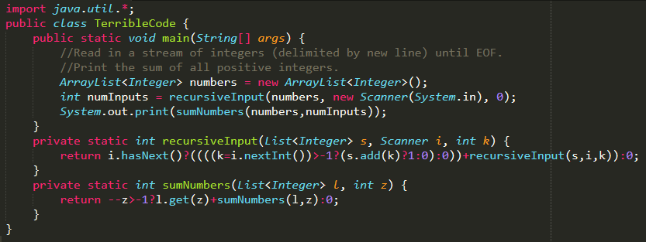
Mystery Code
Better?
Yes. I understand main() now.
Notes:
Split complicated 1-liners (main)

Slide 9
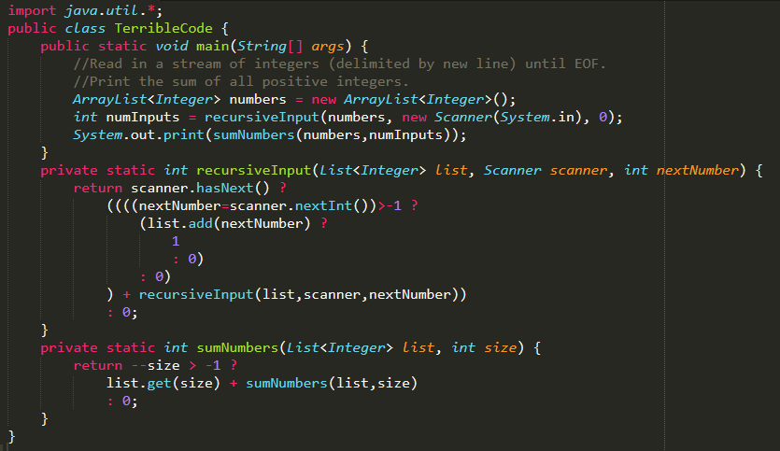
Mystery Code
Better?
Notes:
Split complicated 1-liners (methods)
And rename method parameters

Slide 10
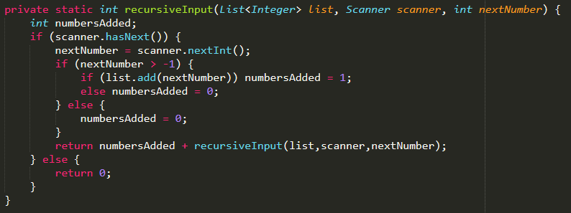
Mystery Code
Done?
No.
Notes:
Change inline ifs into proper ifs

Slide 11
Mystery Code
Done?
No.
Notes:
numbersAdded is useless

Slide 12
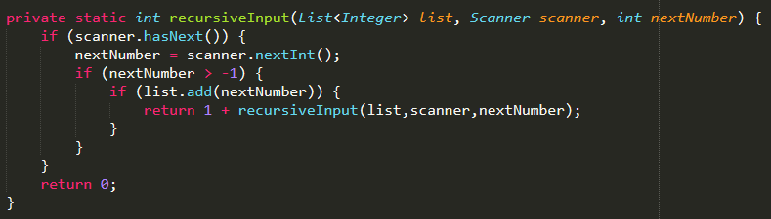
Mystery Code
Done?
Almost.
Notes:
Remove numbersAdded and useless elses

Slide 13

Mystery Code
Done?
Almost.
This is useless code.
Notes:
Remove numbersAdded and useless elses

Slide 14
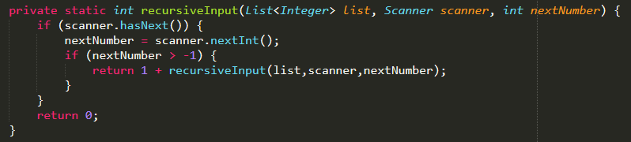
Mystery Code
Done?
Yes!
Notes:
Remove numbersAdded and useless elses

Slide 15
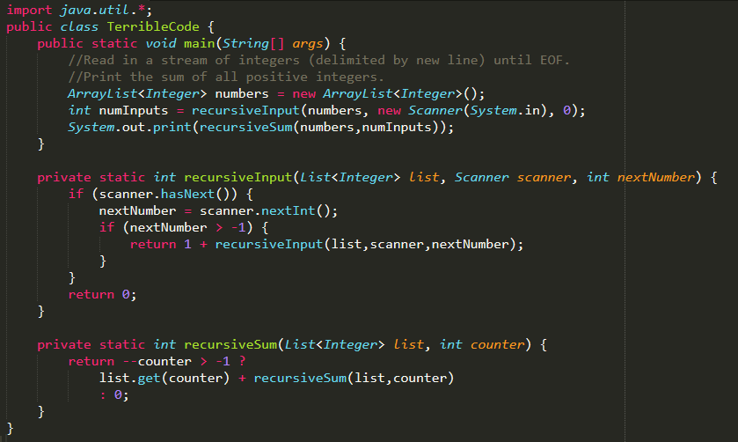
Not Mystery Code
More readable than the original right?
Left as an exercise for the reader.

Slide 16
Like what you see?
http://ioccc.org/ for more bad code.

Slide 17
import java.util.*;
public class j {
public static void main(String[] args) {
//Read in a stream of integers (delimited by new line) until EOF.
//Print the sum of all positive integers.
ArrayList<Integer> l;
System.out.print(new j().f((l=new ArrayList<>()),new j().r(l, new Scanner(System.in), 0)));
}
int r(List<Integer> s, Scanner i, int k) {return i.hasNext()?((((k=i.nextInt())>-1?(s.add(k)?1:0):0))+r(s,i,k)):0;}
int f(List<Integer> l, int z) {return --z>-1?l.get(z)+f(l,z):0; }
}

Slide 18
import java.util.*;
public class j {
//Read in a stream of integers (delimited by new line) until EOF.
//Println the number of non-negative integers, a space, followed by the sum of all positive integers.
//Assume that sum of values will not exceed the size of an integer, and that there are at least 2 values.
public static void main(String[] args) { System.out.println(new j().r(0, new Scanner(System.in), 0)); }
String r(int z, Scanner i, int k) {
return z!=0?(i.hasNext()?((((k=i.nextInt())>-1?((z+=k)!=-1?1:0):"\0"))+r(z,i,~k)):" "+z):Arrays.stream((i.hasNext()?((((k=i.nextInt())>=0?((z+=k)==k?z&1:0):"\0"))+r(z,i,z^k)):" "+z).split(" ")).reduce((a,b)-> (a.length() + " " + b)).get();
}
}

Slide 19
Level 2: Abstracting into methods

Slide 20
Context for the examples
Java pseudocode for a chatbot (based on real old PHP code)

Slide 21
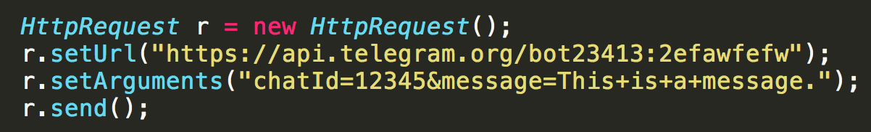
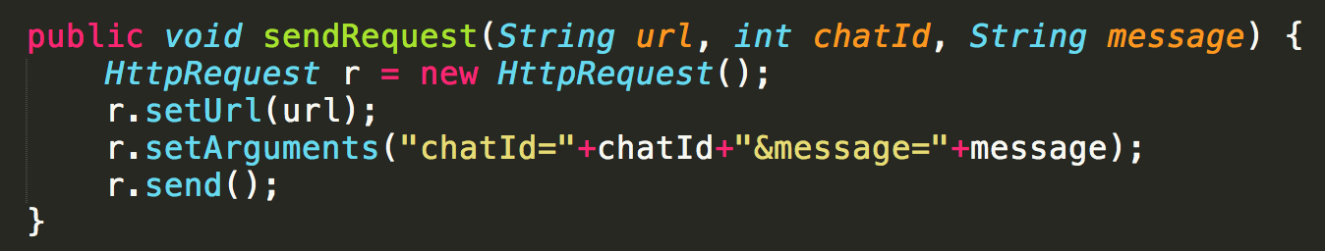
Abstracting into methods
First use case: If you need to copy-paste a block of code, put it into a method
Reduce repetition
Easier to modify
vs
Notes:
First case: Need to copy paste block of code for each message.
Second case: Duplicate 1 line of code

Slide 22
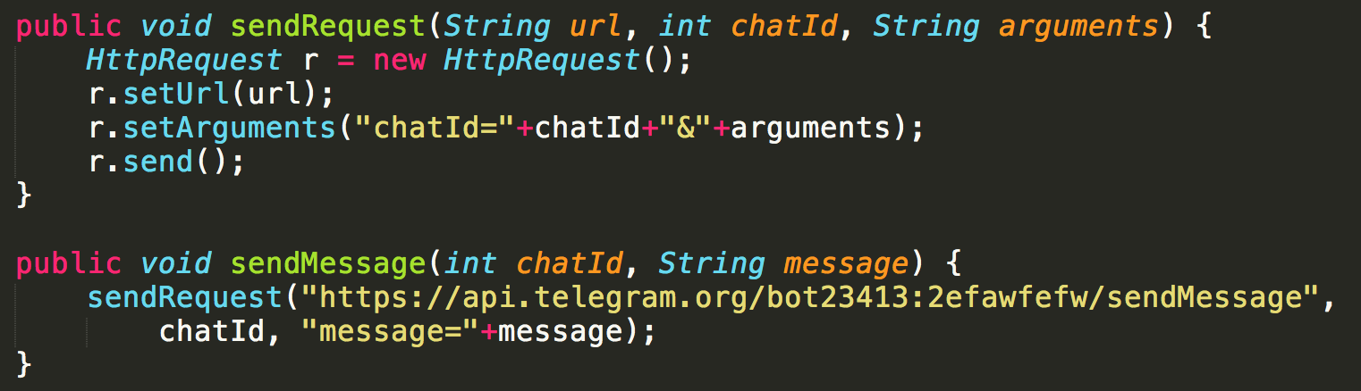
Abstracting into methods
vs
Notes:
First case: Pass the URL into every method call. What if URL changes?
Second case: Change URL in one place

Slide 23
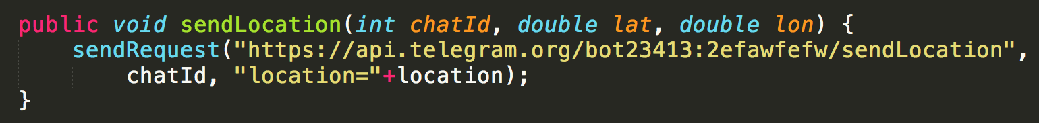
Abstracting into methods
Notes:
Now make it easier to add new functionality

Slide 24
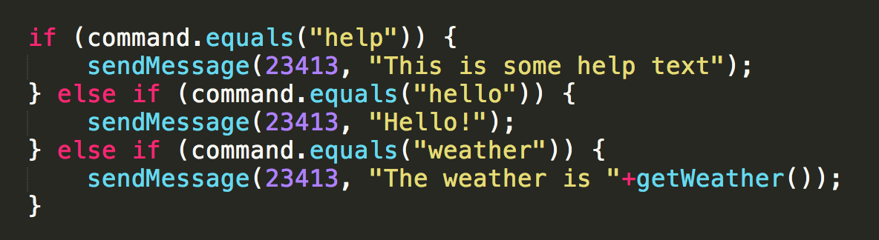
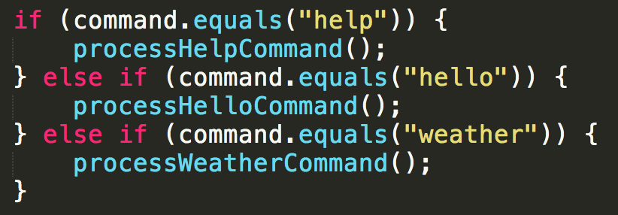
Abstracting into methods
Second use case: Make code cleaner
(this is a very simplified example)
vs

Slide 25
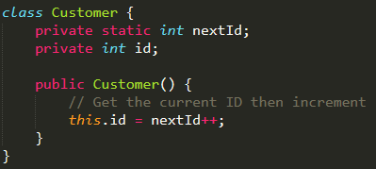
Abstracting into methods
Simpler example
What if I want to be able to reuse IDs?
Example: Restrict IDs between 1000 & 2000 and loop back

Slide 26

Abstracting into methods
Maybe like this?
Example: Restrict IDs between 1000 & 2000 and loop back

Slide 27
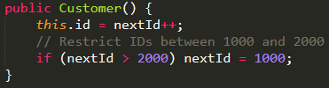
Abstracting into methods
Comments make it clearer?
Example: Restrict IDs between 1000 & 2000 and loop back

Slide 28
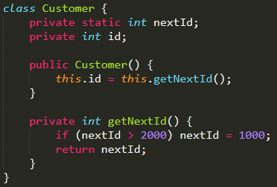
Abstracting into methods
Ask yourself: From the point of view of the constructor, does it need to care about how your IDs are implemented?
No. It just needs the next ID.
Now your ID implementation can change and not affect the rest of the code. E.g. Every even number

Slide 29
Level 3: Abstracting into classes

Slide 30
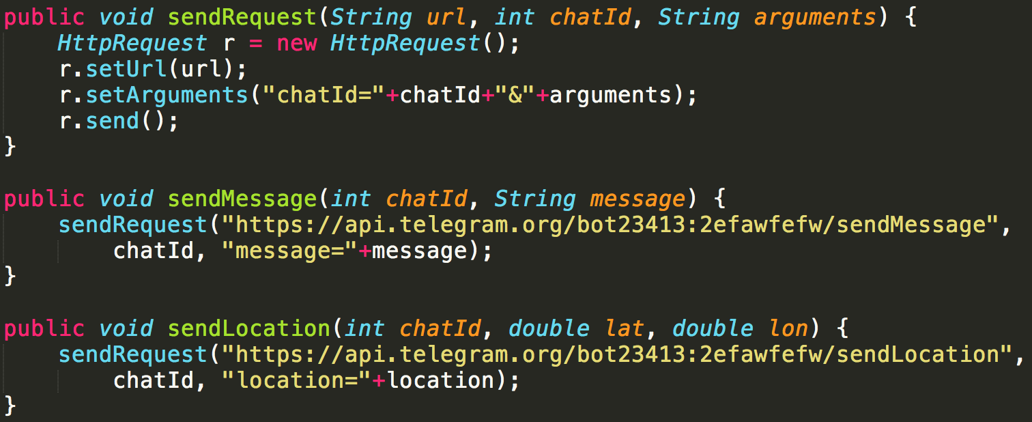
Abstracting into classes
1st Use Case: Share common data

Slide 31
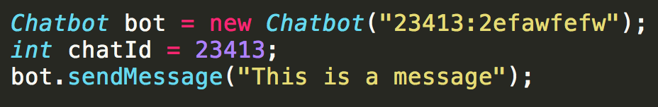
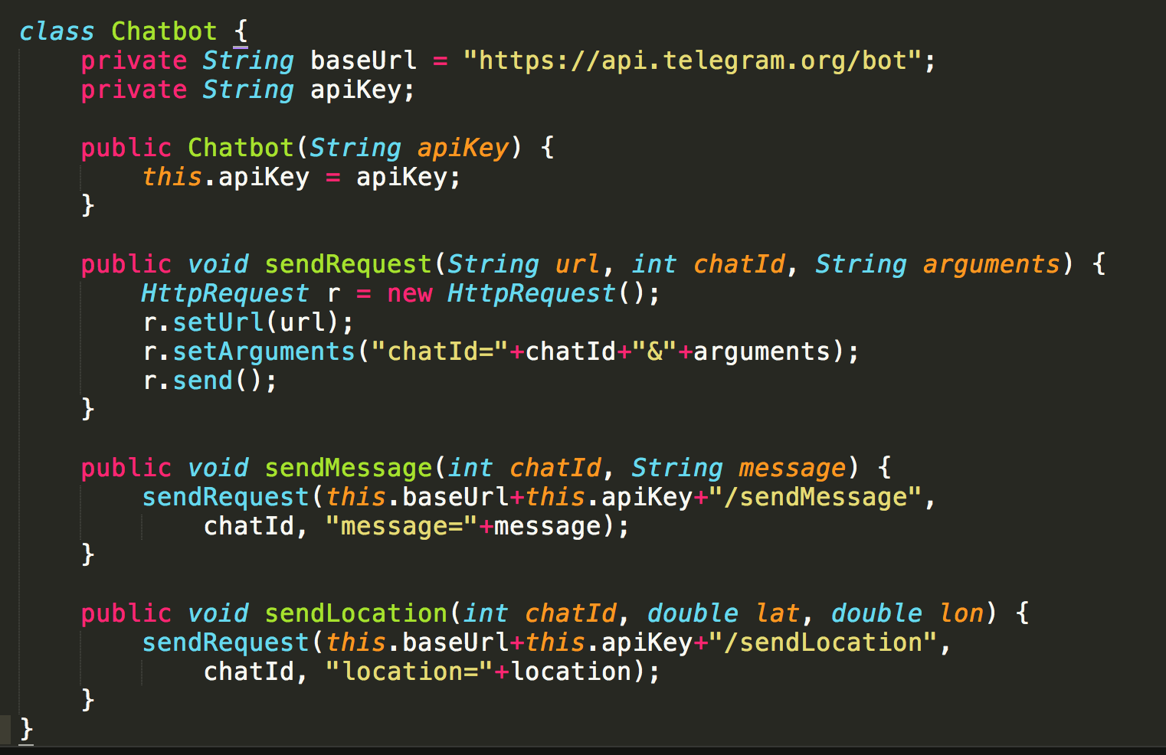
Abstracting into classes

Slide 32
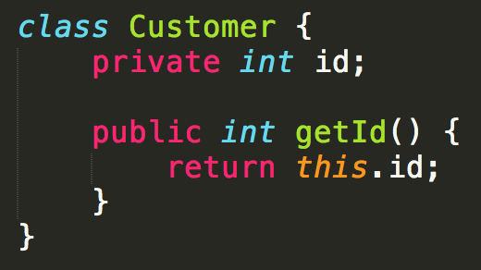
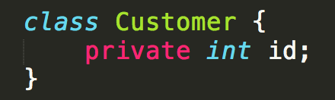


Abstracting into classes
Don’t store the same data twice, only use what you need
vs

Slide 33
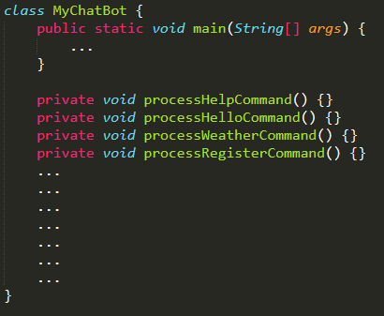
Abstracting into classes
*More advanced* It is okay if you do not understand this part.
Second use case: Too many methods
Each method has many lines of code
Very complicated and hard to navigate

Slide 34
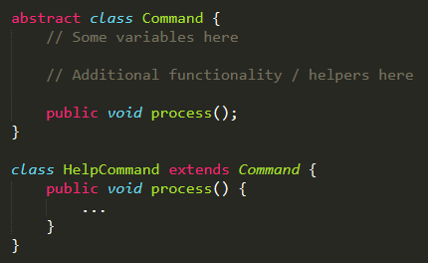
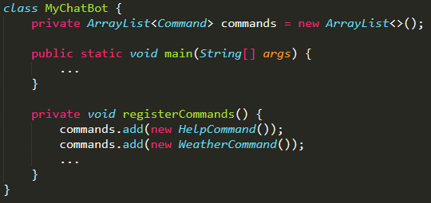
Abstracting into classes
Much more manageable.

Slide 35
If you’re interested in real code
https://github.com/keythkatz/Telegram-Bot-Core
Heavily abstracted with barely any reuse
E.g. HelpCommand extends Command Command extends ForwardableHandler ForwardableHandler extends BaseHandler

